Slide 1

Algebra 1
Unit 7, Lesson 8 Factoring the Difference of Two Squares Volume 1, pg. 397

Slide 2


Benchmark
MA.912.AR.1.7
Rewrite a polynomial expression as a product of polynomials over the real number system.
volume 1, pg. 397

Slide 3
Integrated Mathematical Thinking and Reasoning Standards
MA.K12.MTR.1.1 Actively participate in effortful learning both individually and collectively.
MA.K12.MTR.2.1 Demonstrate understanding by representing problems in multiple ways.
MA.K12.MTR.3.1 Complete tasks with mathematical fluency.
MA.K12.MTR.4.1 Engage in discussions that reflect on the mathematical thinking of self and others.
MA.K12.MTR.5.1 Use patterns and structure to help understand and connect mathematical concepts.
volume 1, pg. 397

Slide 4

Learning Targets
I can factor a difference of two squares.
I can rewrite a polynomial expression as a product of polynomials by factoring.
volume 1, pg. 397

Slide 5

Warm-Up
volume 1, pg. 398

Slide 6
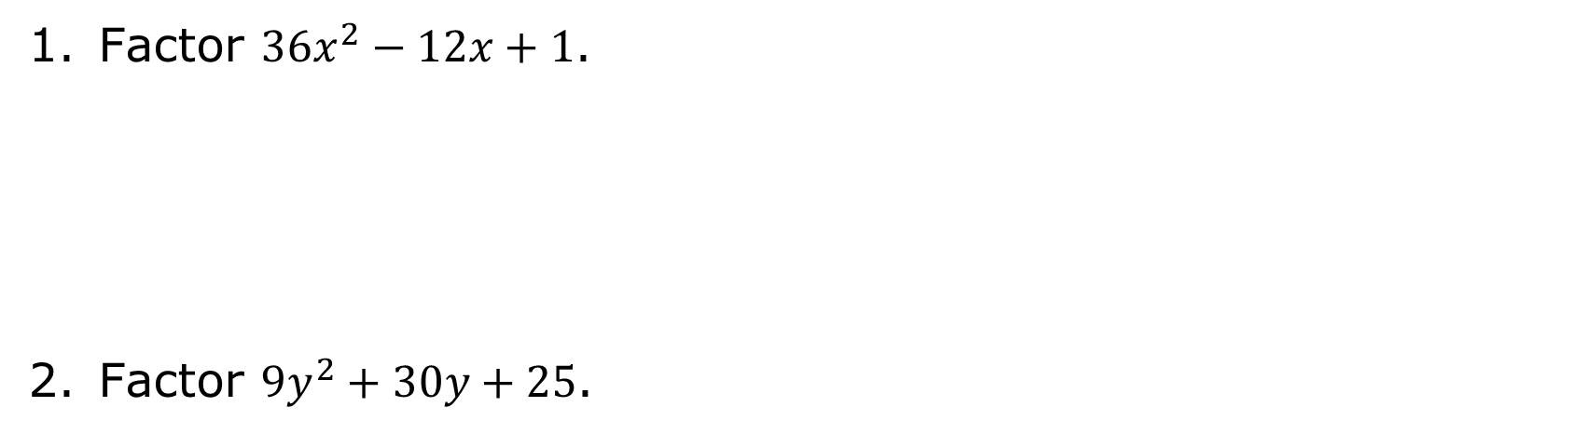
7.8.1 Warm-Up: Bell Work
Factor $36x^{2}−12x+1$.
Factor ${9y}^{2}+30y+25$.
volume 1, pg. 398

Slide 7

Exploration
volume 1, pg. 398

Slide 8

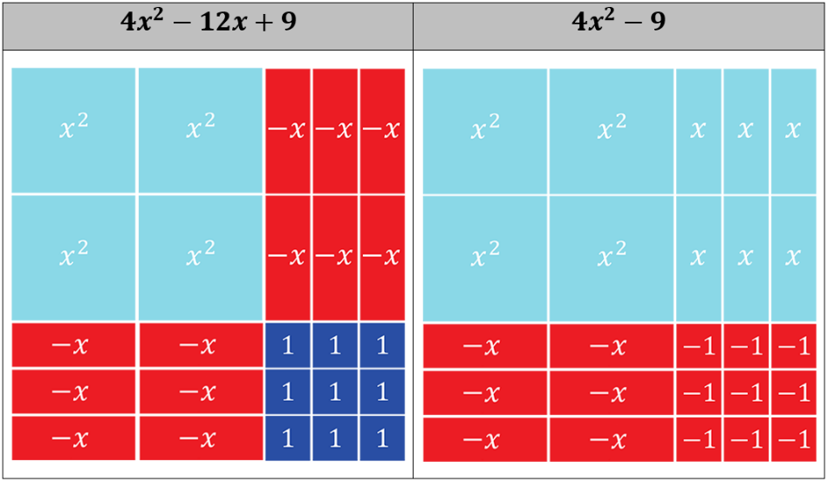
7.8.2 Exploration: What Is a Difference of Two Squares?
The table shows two algebra tile models and their corresponding expressions.
volume 1, pg. 398

Slide 9
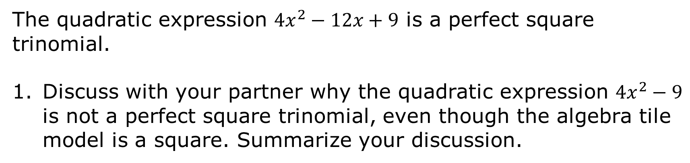
The quadratic expression $4x^{2}−12x+9$ is a perfect square trinomial.
Discuss with your partner why the quadratic expression $4x^{2}−9$ is not a perfect square trinomial, even though the algebra tile model is a square. Summarize your discussion.
volume 1, pg. 398

Slide 10
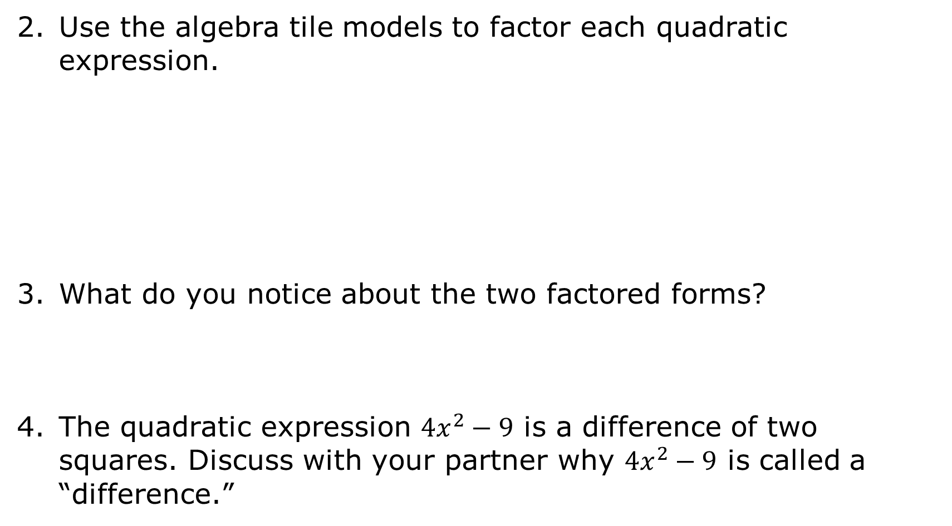
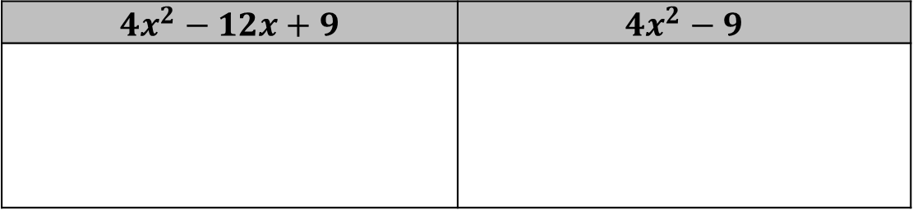
Use the algebra tile models to factor each quadratic expression.
What do you notice about the two factored forms?
The quadratic expression $4x^{2}−9$ is a difference of two squares. Discuss with your partner why $4x^{2}−9$ is called a “difference.”
$$4x^{2}−12x+9$$ | $$4x^{2}−9$$
volume 1, pg. 399

Slide 11
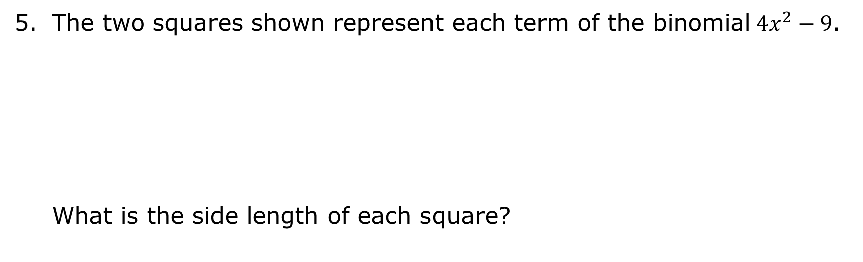
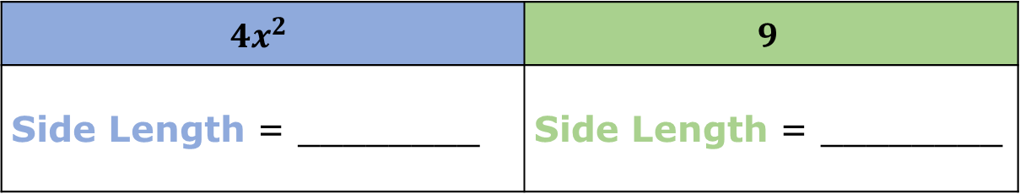


The two squares shown represent each term of the binomial$4x^{2}−9$.
What is the side length of each square?
$$4x^{2}$$
$$9$$
$$4x^{2}$$ | $$9$$
Side Length = ________ | Side Length = ________
volume 1, pg. 399

Slide 12

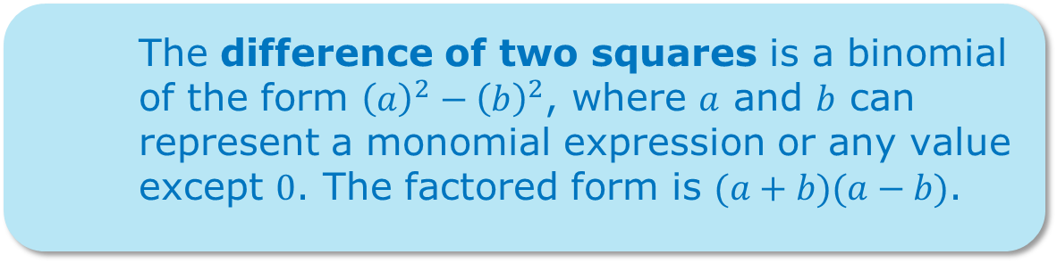
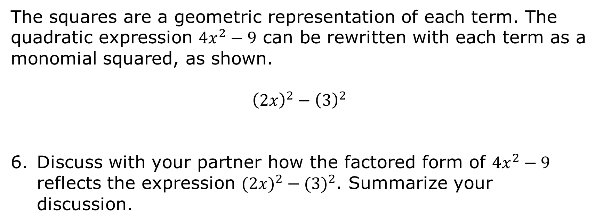
The squares are a geometric representation of each term. The quadratic expression $4x^{2}−9$ can be rewritten with each term as a monomial squared, as shown.
$${\left(2x\right)}^{2}−{\left(3\right)}^{2}$$
Discuss with your partner how the factored form of $4x^{2}−9$ reflects the expression $(2{x)}^{2}−{(3)}^{2}$. Summarize your discussion.
The difference of two squares is a binomial of the form ${\left(a\right)}^{2}−{\left(b\right)}^{2}$, where $a$ and $b$ can represent a monomial expression or any value except $0$. The factored form is $(a+b)(a−b)$.
volume 1, pg. 399

Slide 13
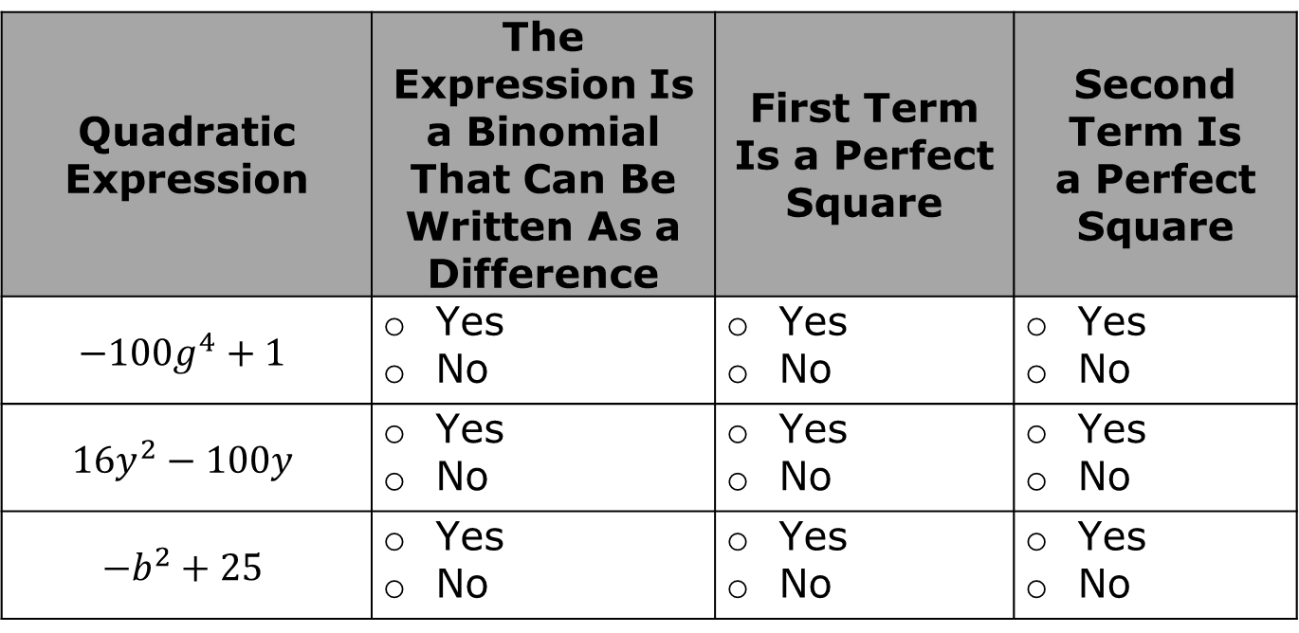
Use the table to determine if each expression is a difference of two squares.
Quadratic Expression | The Expression Is a Binomial That Can Be Written As a Difference | First Term Is a Perfect Square | Second Term Is a Perfect Square
$${−100g}^{4}+1$$ | Yes No | Yes No | Yes No
$${16y}^{2}−100y$$ | Yes No | Yes No | Yes No
$${−b}^{2}+25$$ | Yes No | Yes No | Yes No
volume 1, pg. 400

Slide 14
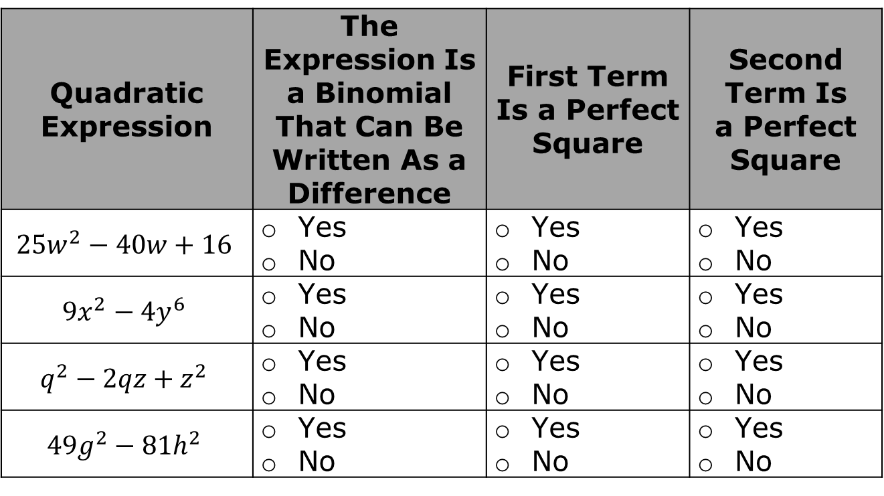
Quadratic Expression | The Expression Is a Binomial That Can Be Written As a Difference | First Term Is a Perfect Square | Second Term Is a Perfect Square
$${25w}^{2}−40w+16$$ | Yes No | Yes No | Yes No
$$9x^{2}−4y^{6}$$ | Yes No | Yes No | Yes No
$$q^{2}−2qz+z^{2}$$ | Yes No | Yes No | Yes No
$${49g}^{2}−81h^{2}$$ | Yes No | Yes No | Yes No
Complete the table.
Circle the expressions in the table that are considered a difference of two squares, based on your check marks.
volume 1, pg. 400

Slide 15

Guided Practice
volume 1, pg. 400

Slide 16

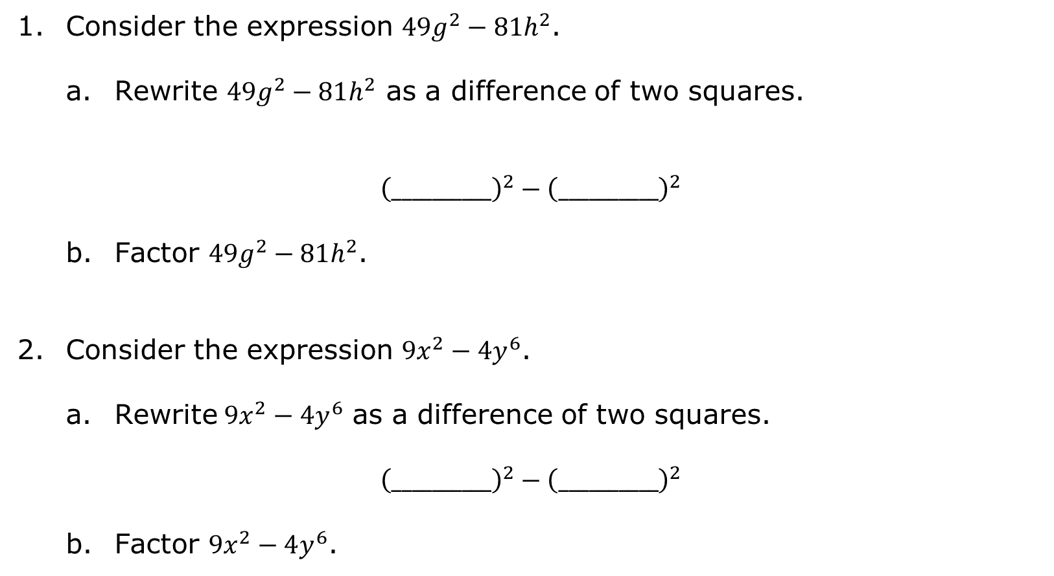
7.8.3 Guided Practice: Factoring a Difference of Two Squares
Consider the expression ${49g}^{2}−81h^{2}$.
Rewrite ${49g}^{2}−81h^{2}$ as a difference of two squares.
$${\left(__________\right)}^{2}−{\left(__________\right)}^{2}$$
Factor ${49g}^{2}−81h^{2}$.
Consider the expression $9x^{2}−4y^{6}$.
Rewrite$9x^{2}−4y^{6}$ as a difference of two squares.
$${\left(__________\right)}^{2}−{\left(__________\right)}^{2}$$
Factor $9x^{2}−4y^{6}$.
volume 1, pg. 400

Slide 17
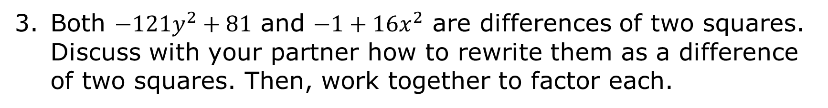
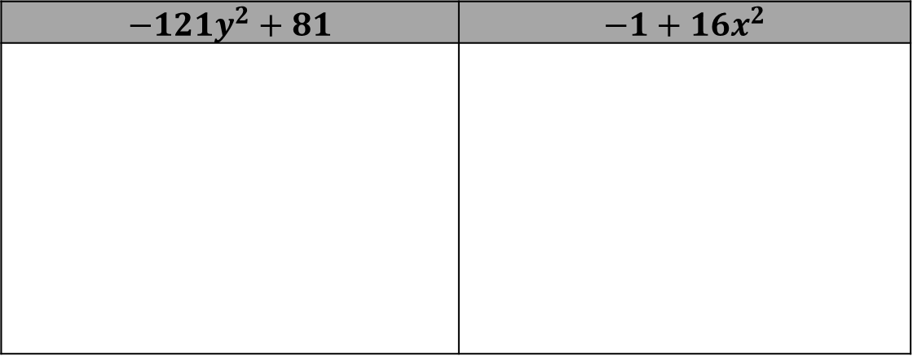
Both $−121y^{2}+81$ and $−1+16x^{2}$ are differences of two squares. Discuss with your partner how to rewrite them as a difference of two squares. Then, work together to factor each.
$$−121y^{2}+81$$ | $$−1+16x^{2}$$
volume 1, pg. 401

Slide 18

Try It
volume 1, pg. 401

Slide 19

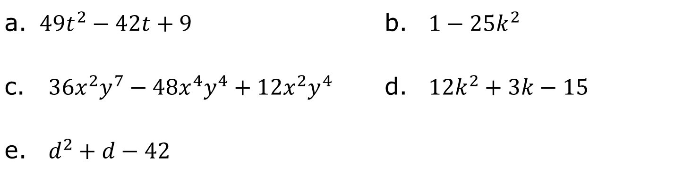
7.8.4 Try It: Factoring Polynomials
This is a mixed practice, which includes all of the different types of polynomials factored in this unit. If necessary, review previous lessons for examples of how to factor each type.
Factor each expression.
$49t^{2}−42t+9$ |  | $1−25k^{2}$
${36x}^{2}y^{7}−48x^{4}y^{4}+12x^{2}y^{4}$ |  | $12k^{2}+3k−15$
$d^{2}+d−42$
volume 1, pg. 401

Slide 20

Your Turn
volume 1, pg. 402

Slide 21
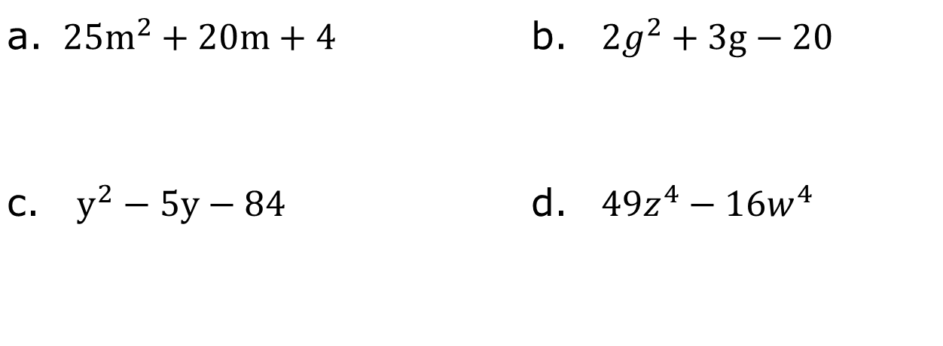
7.8.5 Your Turn!
Factor each expression.
$25m^{2}+20m+4$ |  | $2g^{2}+3g−20$
$y^{2}−5y−84$ |  | $49z^{4}−16w^{4}$
volume 1, pg. 402

Slide 22

Wrap-Up
volume 1, pg. 402

Slide 23
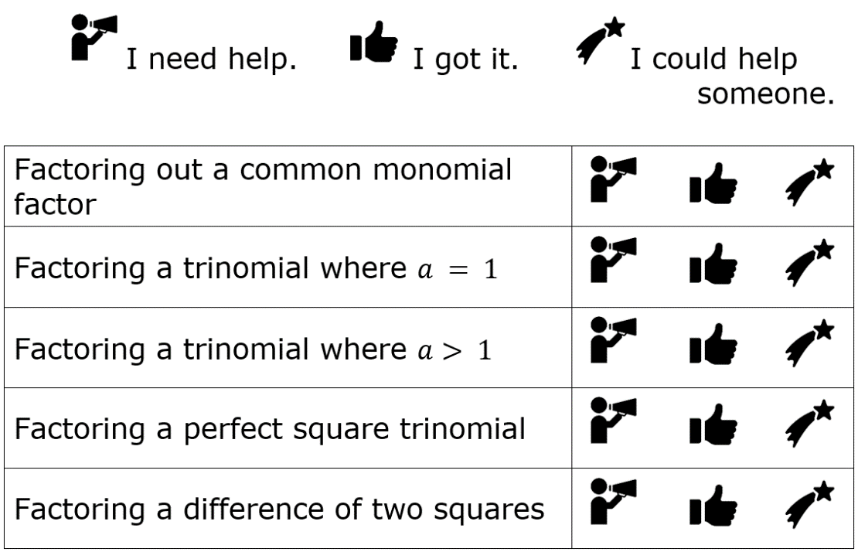
7.8.6 Wrap-Up: Reflection
Circle the icon that best describes your understanding of each concept.
volume 1, pg. 402

